Slide 1


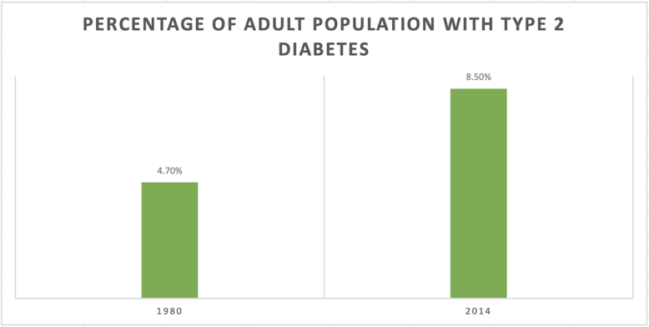
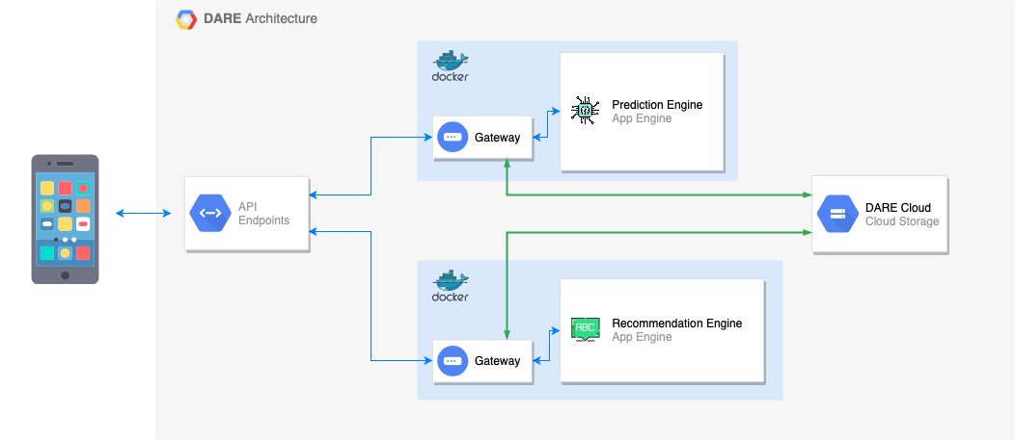

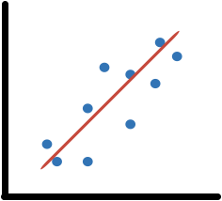

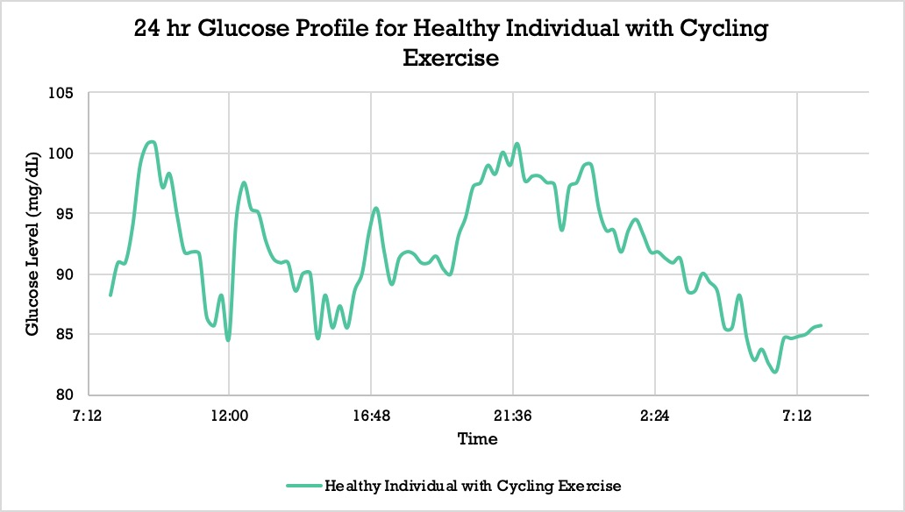
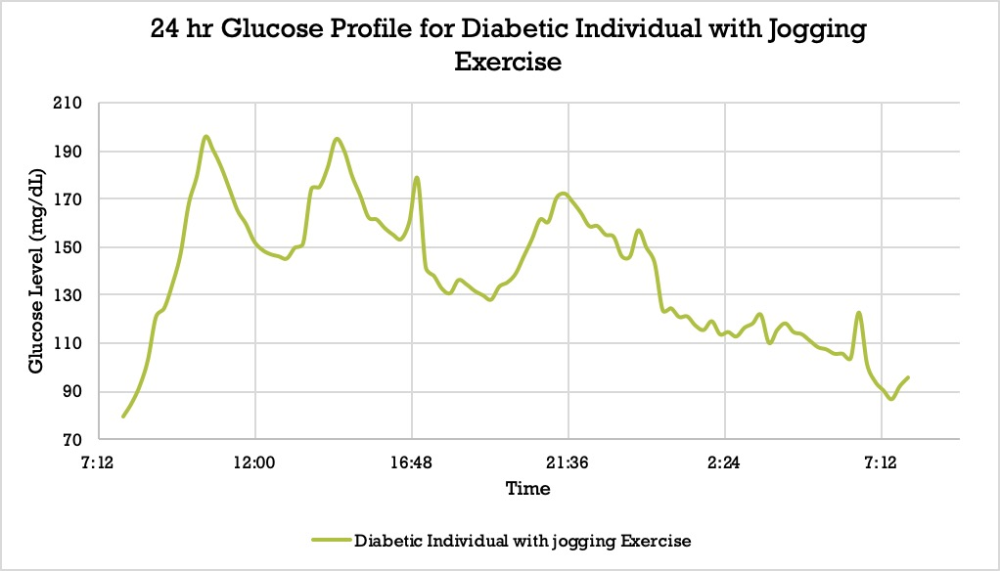
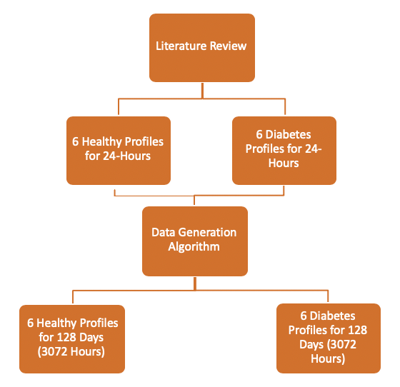
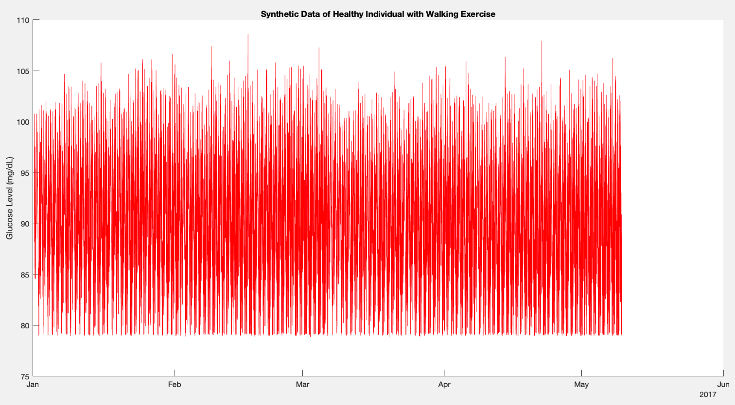
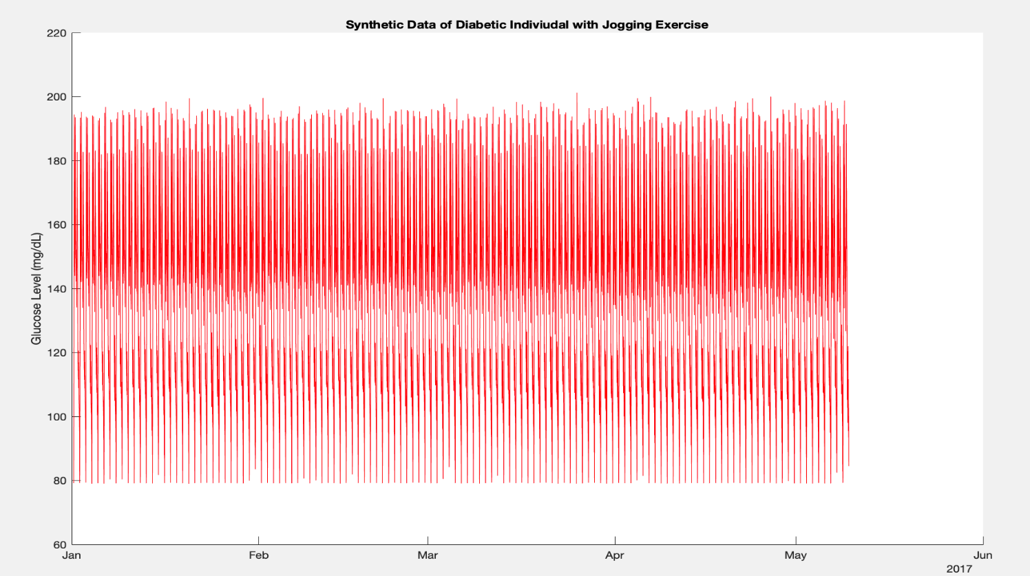


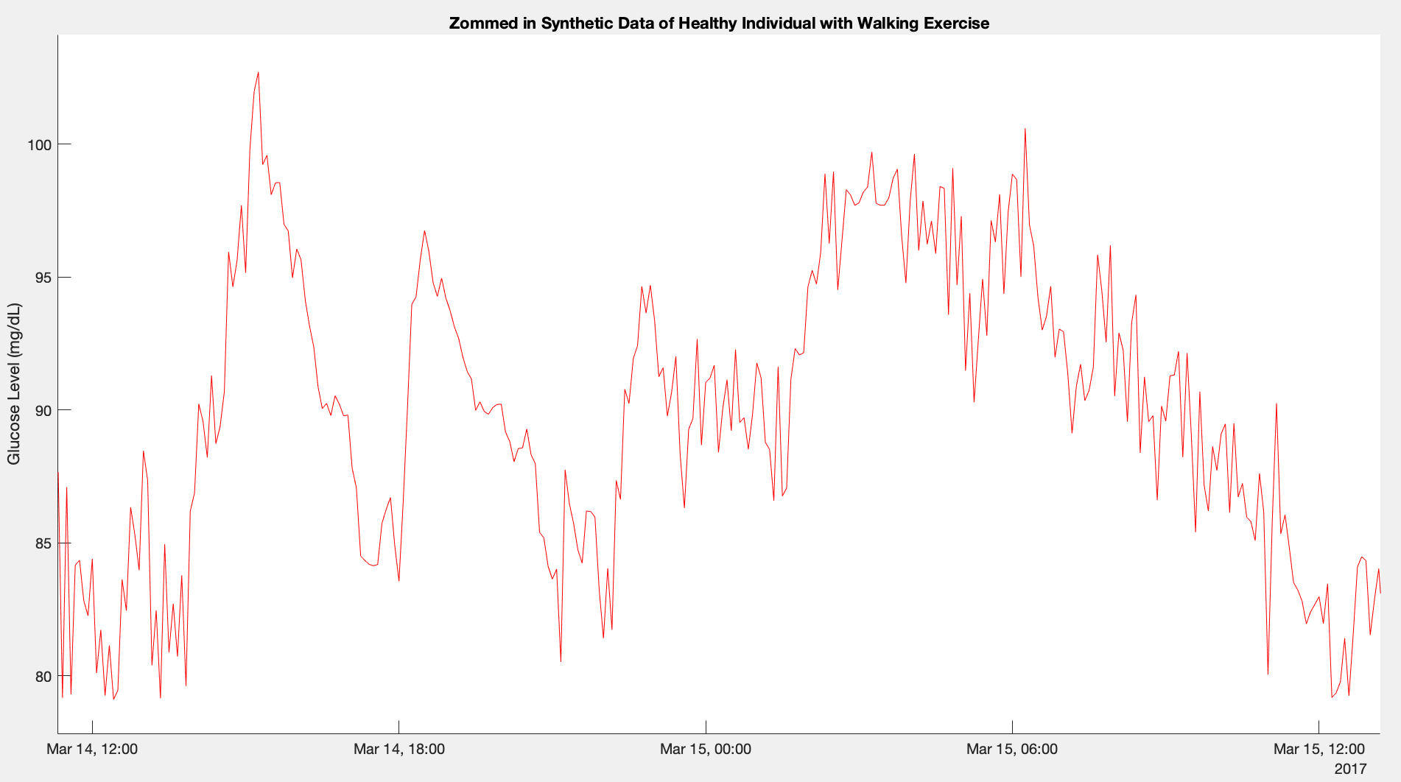
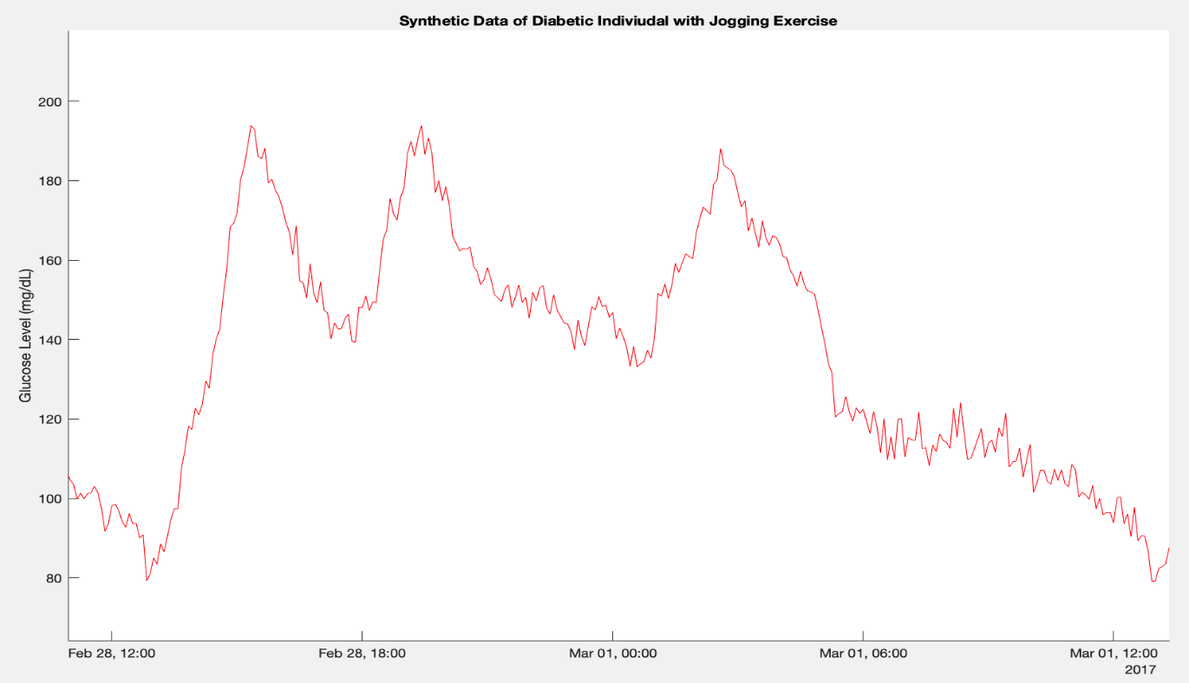

DARE: Diabetes Analytics and Recommendation Engine
Leen Yassin Kassab, Lama Yassin Kassab, Pooria Shafia, Joe Samuel, Mohamed Hozayen
Carleton University, Ottawa, Ontario, Canada
Mohamed Ibnkahla, Zied Bouida
Motivation
System Architecture
Objective:
To Design a Smart System that
Allows Patients to Self-Manage T2DM
Type II Diabetes Mellitus (T2DM):
Characterized by High Glucose Levels in the Blood [1]
Risk Factors include: [1]
Family History
Cardiovascular Disease
Lack of Exercise
If untreated, results in damage to body organs: [2]
Eyes
Kidneys
Statistics Suggest: [3]
Rising Trending in the Number of Diabetes Patients
l
Goals and Requirements
Infrastructure Scalability
Data privacy and security
Compliance with data-governing laws (such as HIPAA)
Big data ready
Modular design
Independently deployable
Architecture Components
Native Smartphone Application
Application Interface (API) Endpoints
Prediction Engine
Recommendations Engine
DARE Cloud datastore
Architecture Choices
Containerization to establish modularity, and scalability
Anonymized data collection for data security
Single Access Gateway per component for improved security through Access Control
Architecture Features
Containerization of the Prediction Engine and Recommendations Engine through Docker containers
Scalable by infrastructure using Kubernetes and containerized deployment
HIPAA compliant using end-to-end encryption for data interchange
Independently functional components for integration into 3rd party systems
Independently deployable containers
API standardization for each module
Big data ready thanks to object data persistence model
Anonymized data storage with a private key and public key on device for secure identification.
Type 2 Diabetes
8.5%
4.7%
1980
2014
Design Principles
Built for evolution
User-centric
Data privacy with laws and requirements (such as HIPAA)
Separation of concerns
Service-Oriented Architecture
Design Requirements
Objectives
Application Level Requirements
Data Analytics Engine
Use glucose, sleep, diet, exercise and sleep data
Predict short-term and long-term glucose levels
Generate individualized Recommendations
Correlation between Factors
System Level Requirements
Programming Languages: Design system using MATLAB, Python
Modularity: Each part of the system must work independently of other parts
Interface: containerize system using Docker
Data Generation
Recommendation Engine
Goal and Requirements
To Train the Prediction and Recommendations Engines
Large Datasets Containing Glucose Levels
Healthy and Diabetic Individuals Data
Diet, Exercise, Sleep and Stress Data
Challenge and Solution:
Required Datasets are not Available
Shifted to Synthetic Data Generation
Data Generation Algorithm:
Input:
Glucose Data Over 24 hours in
5-minute Interval from the Literature
Number of the Highest Peaks
Output:
Glucose Data for 128 Days (3072 hours)
in 5-minute Interval
The Developed Algorithm:
Peaks Detection
Simple Random Noise Addition
Horizontal Shifts
Data Cleanup: Removal of Low Extremities
Competitors
Similarities
Differences
Synthetic Data of Healthy Profile with Cycling Exercise
Synthetic Data of Diabetic Profile with Jogging Exercise
Tracks and analyzes blood sugar, and lifestyle activity.
Estimates future glucose value to provide suggestion.
Collects information such as diet, stress, and exercise but does not harness the data for correlations in predicting glucose levels.
Tracks blood sugar, insulin, medication and food intake.
The app does not provide recommendations to better manage the disease.
Zoomed-in Synthetic Data of Healthy Profile with Cycling Exercise
Zoomed-in Synthetic Data of Diabetic Profile with Jogging Exercise
Summary of the Obtained Profiles:
Provides personalized guidance based on glucose, medications, current health, and a review of lifestyle factors.
Healthy Profiles
Profile 1: | No Exercise
Profile 2: | Standing Exercise
Profile 3: | Walking Exercise
Profile 4: | Cycling Exercise
Profile 5: | Enough Sleep
Profile 6: | Special Diet
Diabetic Profiles
Profile 7: | Good habits
Profile 8: | No exercise
Profile 9: | Jogging exercise
Profile 10: | Stress
Profile 11: | Enough sleep
Profile 12: | Not enough sleep
The app can only be used with a medical prescription.
Requires registration.
References:
[1] D. Of and D. Mellitus, “Diagnosis and classification of diabetes mellitus,” Diabetes Care, vol. 37, no. SUPPL.1, pp. 81–90, 2014.
[2] H. Wu, S. Yang, Z. Huang, J. He, and X. Wang, “Type 2 diabetes mellitus prediction model based on data mining,” Informatics Med. Unlocked, vol. 10, no. December 2017, pp. 100–107, 2018.
[3] World Health Organization, “Global Report on Diabetes,” Isbn, vol. 978, p. 88, 2016.

Slide 2
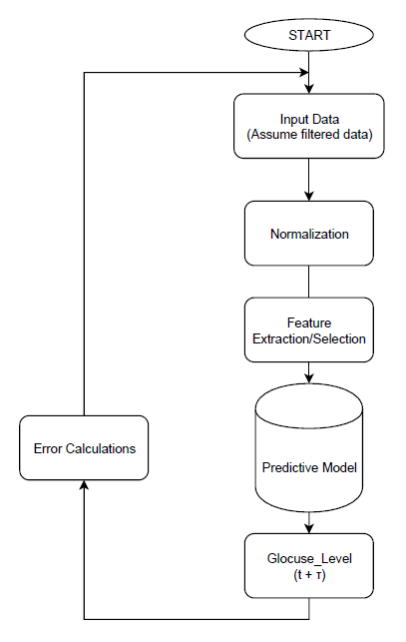
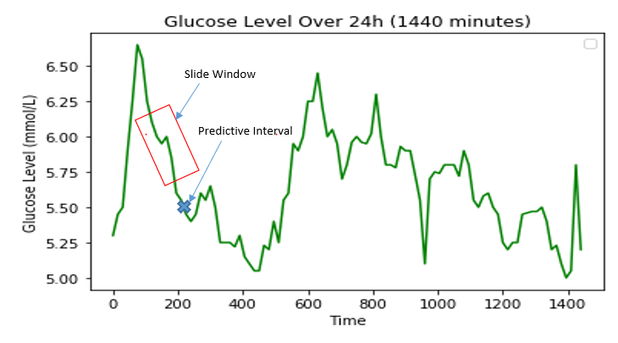
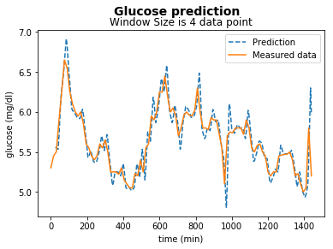
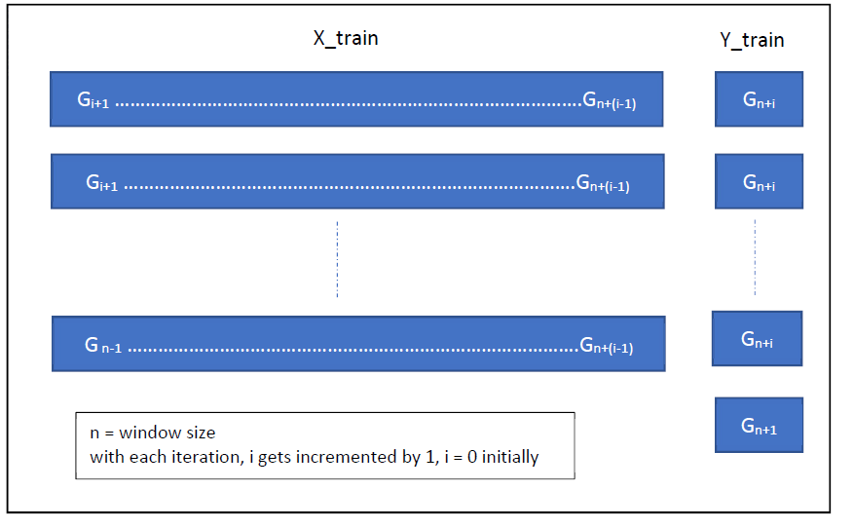
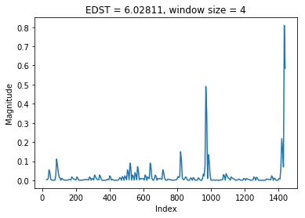
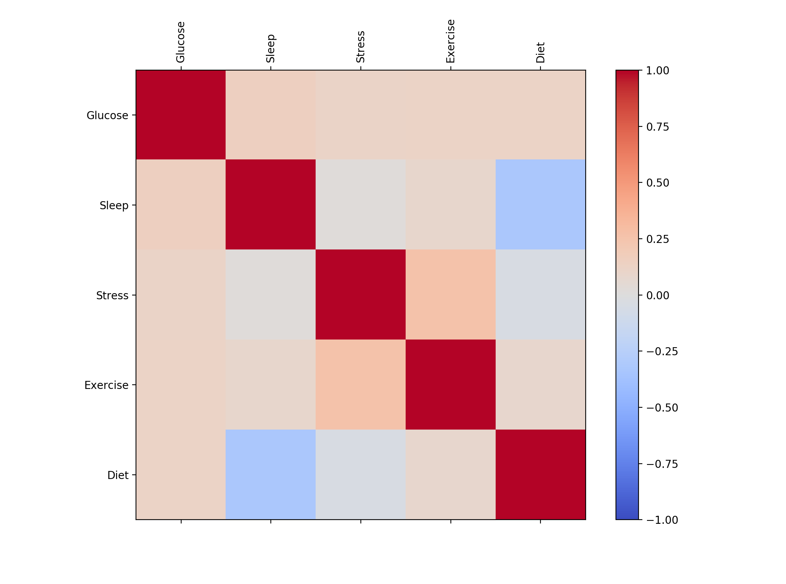
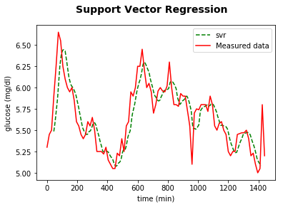
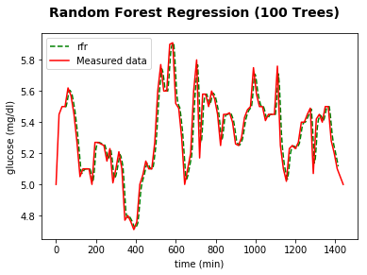
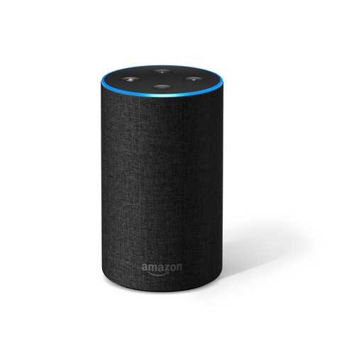
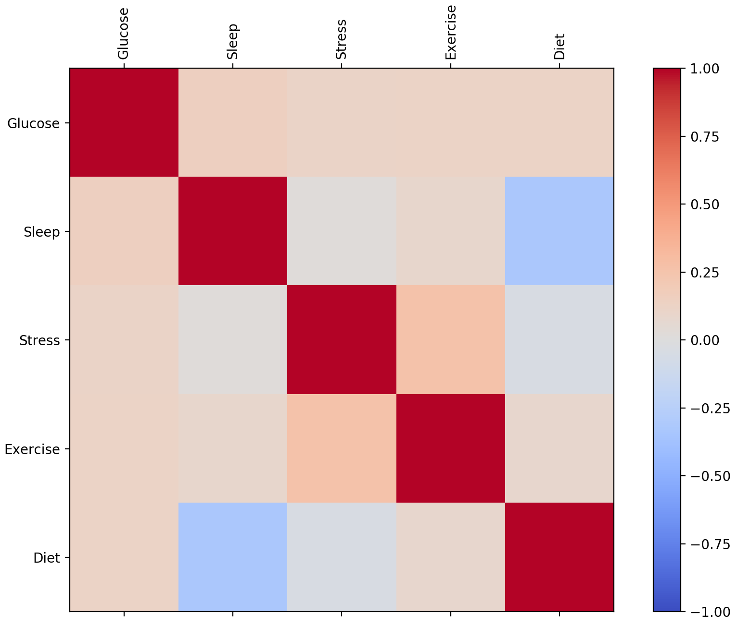

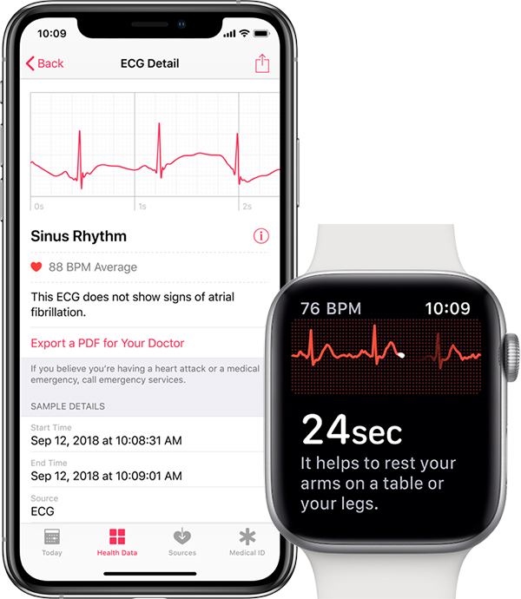
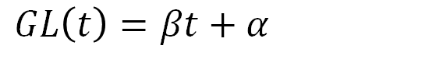

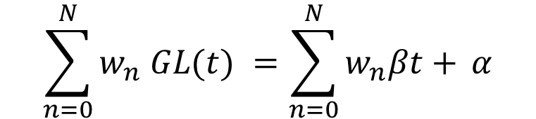
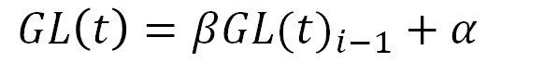
DARE: Diabetes Analytics and Recommendation Engine
Leen Yassin Kassab, Lama Yassin Kassab, Pooria Shafia, Joe Samuel, Mohamed Hozayen
Carleton University, Ottawa, Ontario, Canada
Mohamed Ibnkahla, Zied Bouida
Prediction Engine
Results
Goals and Requirements
Long-Term Predictions
Short-Term Predictions
Computation Complexity
Real-Time Processing time
Framework Architecture
Preprocessing and Filtration
Normalization
Feature Selection
Predictive Model
Output
Error Calculations
Porotype Model: Short-Term
Simple Linear Regression
Weighted Linear Regression
Slide Window
Predictive Interval
Error Calculations
Implementation: Weighted Linear Regression
Error Difference Square (EDS)
Long-Term Predictions: Time-Series Models
Long-Short Term Memory LSTM
Feed-Forward Neural Network FFNN
Recurrent Neural Network RNN
Time-Series Analysis:
Prediction Engine Integrations
Expert System – Model Aggregation
Processing Requirements and Speed
Optimization Decisions
Data Generation:
Successfully generated glucose data for 128 days from 1 day’s data
$GL\left(t\right)=β{GL(t)}_{i−1}+$ $α$
Prediction Engine:
Short-term prediction: glucose level predicted from input glucose for the next hour
Long-term prediction: generated based on time-series analysis by generating training sets and testing sets based on sleep, diet, exercise, and stress.
Trains neural network to learn the behaviour of the signal over long periods with respect to the factors.
$$EDST=\sum_{n=0}^{N}{(y_{r}− }y_{p}) ^{2}$$
Recommendations Engine:
A flexible, modular engine capable of providing recommendations when:
Only glucose is available
Glucose data as well as other current factors are available
Historical data is available resulting in the most accurate recommendations using weighted and ranked factors
Support Vector Regression
Random Forest Regression
Glucose
Sleep
Stress
Exercise
Diet
1
$GL\left(t\right)=βt+$ $α$
Glucose
0.75
Sleep
0.50
$$\sum_{n=0}^{N}{w_{n} GL(t)} =\sum_{n=0}^{N}{w_{n}βt+ }α$$
0.25
Stress
0
Exercise
-0.25
-0.50
Diet
-0.75
-1
Recommendation Engine
Impact
Patient Benefits
Assist diabetic patients to interactively manage their glucose levels
Receive comprehensive health recommendations through advanced correlations of daily routines
Harness smart Internet of Things devices for accurately input health data
Research Benefits
Improvement in prediction patterns and improved recommendations thanks to neural networks
Identify correlation patterns between glucose levels, sleep, stress, exercise, and diet to assist in further biomedical research
Goals and Requirements:
Generate recommendations based on user input and historical data
Generate recommendations when only glucose is available
Generate recommendations when other factors available
Individualize recommendations when historical data is available
Recommendation Engine
Predicted Glucose
Weighted Factors Analysis
Recommendation Generator
Recommendation
Sleep
“Try deep breathing for 2 mins”
“Have you tried mindfulness?”
“Snacking can help you regulate your glucose level!”
“Go for a walk!”
Exercise
Diet
Single-Factor Analysis
Stress
Historical Data
Input Data
Recommendation Algorithm
Future Work
Weighted Factors Analysis:
Finds factor correlations based on historical data
Factors are ranked for more accurate and individualized recommendations
Single-Factor Analysis:
Uses glucose data to output a recommendation.
Additional factors may be entered by the user to receive more specific recommendations
Normal Glucose?
Yes
Available Factors OK?
Yes
Encouraging Message
No
No
Refine neural network models with improved correlation datasets
Improved recommendations engine to base recommendations on enhanced parallel correlations among multiple data sources
Integrating with native OS-based health APIs for improved data input accuracy
Formulate a larger correlated dataset for future research
Factors Available?
No
Prompt user to input more data (optional)
Check which factor needs to be addressed
Spearman Correlation Coefficient:
Determines degree of relationship between variable
Advantage over Pearson’s R: No assumption on data normality
Advantages of this Architecture:
Highly modularized: each component works independently and can easily be changed to adapt to requirements.
Flexibility: recommendations generated based on input data
Yes
Find correlation between factors and rank them
Check if glucose is too low or high
Generate a
Recommendation

Slide 3

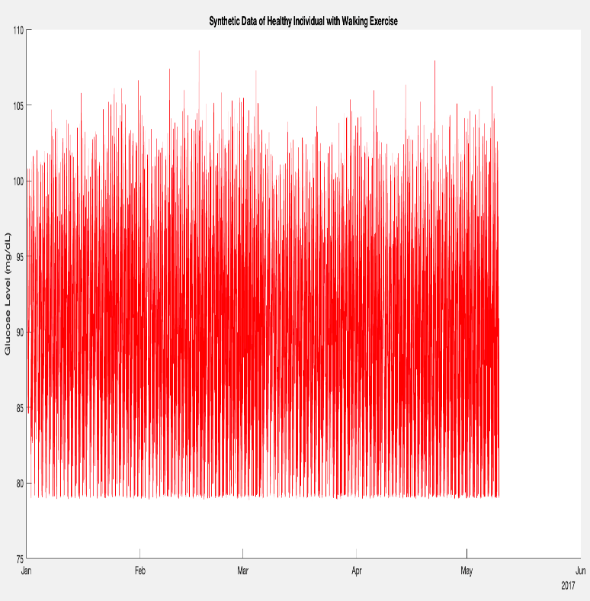

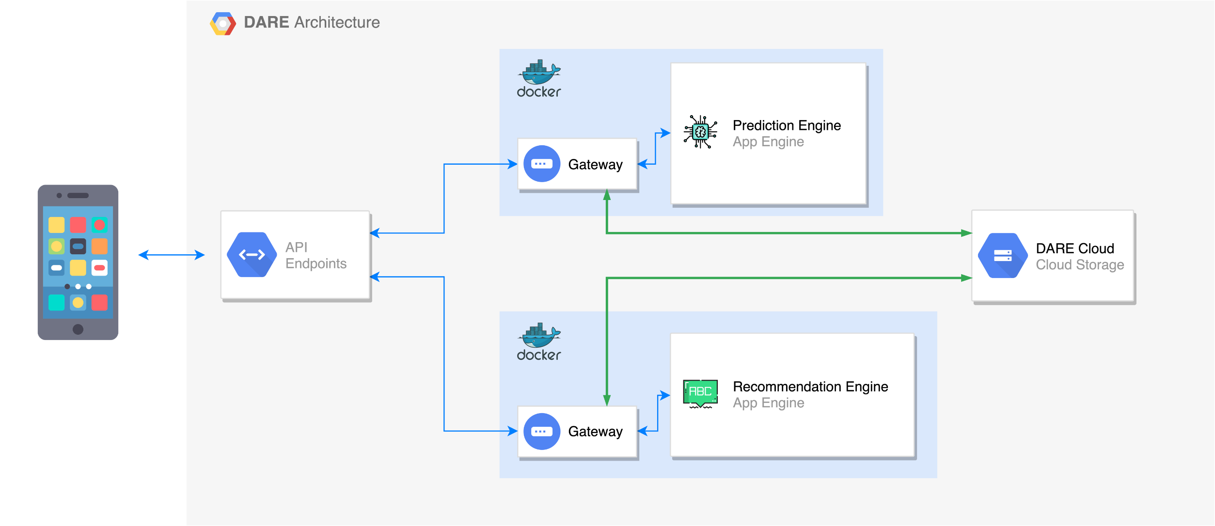

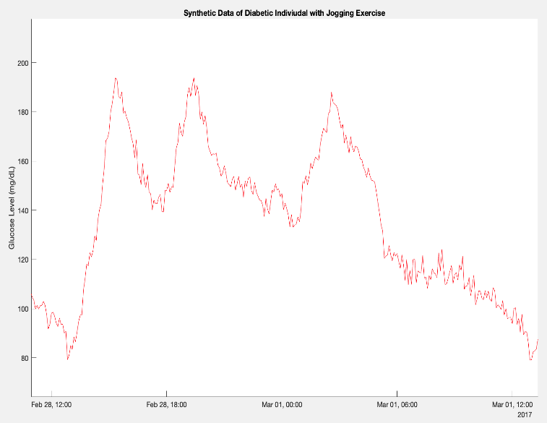

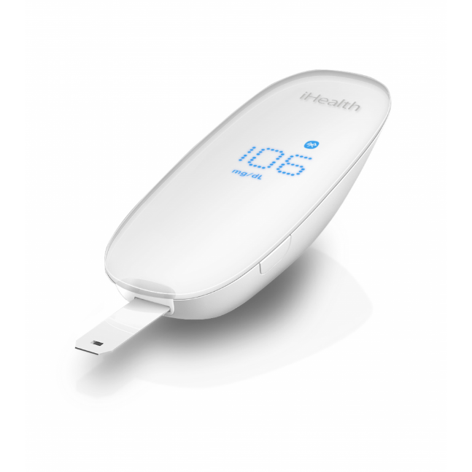
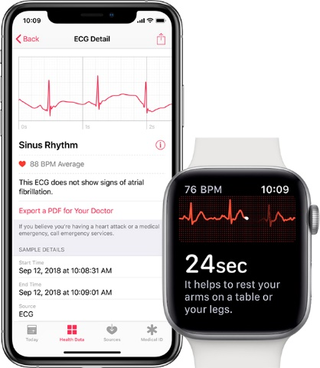
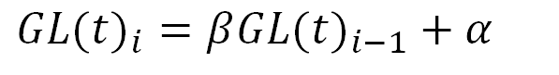
DARE: Diabetes Analytics and Recommendation Engine
Leen Yassin Kassab, Lama Yassin Kassab, Pooria Shafia, Joe Samuel, Mohamed Hozayen
Carleton University, Ottawa, Ontario, Canada
Mohamed Ibnkahla, Zied Bouida
Motivation
System Architecture
Data Generation
Results
l
Type II Diabetes Mellitus (T2DM):
Characterized by High Glucose Levels in the Blood [1]
Risk Factors include: [1]
Cardiovascular Disease
Lack of Exercise
If untreated, results in damage to body organs: [2]
Eyes
Kidneys
Statistics Suggest: [3]
Rising Trending in the Number of Diabetes Patients
Architecture Features
Containerization of the Prediction Engine and Recommendations Engine through Docker containers
Scalable infrastructure using Kubernetes and containerization
HIPAA compliant using end-to-end encryption for data interchange
Independently deployable containers
API standardization for each module
Big data ready thanks to object data persistence model
Anonymized data storage with a private key and public key on device for secure identification.
Independently functional components for integration into 3rd party systems
The Developed Algorithm:
Peaks Detection
Simple Random Noise Addition
Horizontal Shifts
Data Cleanup: Removal of Low Extremities
Data Generation
Successfully generated glucose data for 128 days from 1 day’s data
Prediction Engine
Short-term prediction: glucose level predicted from input glucose for the next hour
Long-term prediction: generated based on time-series analysis by generating training sets and testing sets based on sleep, diet, exercise, and stress.
Trains neural network to learn the behaviour of the signal over long periods with respect to the factors.
Objective:
To Design a Smart System that allows Patients to Self-Manage T2DM
Synthetic Data of Healthy Profile with Cycling Exercise
Synthetic Data of Diabetic Profile with Jogging Exercise
Summary of the Obtained Profiles:
Healthy Profiles
Profile 1: | No Exercise
Profile 2: | Standing Exercise
Profile 3: | Walking Exercise
Profile 4: | Cycling Exercise
Profile 5: | Enough Sleep
Profile 6: | Special Diet
Recommendations Engine
Design Requirements
Objectives
A flexible, modular engine capable of providing recommendations when:
Only glucose is available
Glucose data as well as other current factors are available
Historical data is available resulting in the most accurate recommendations using weighted and ranked factors
Diabetic Profiles
Profile 7: | Good habits
Profile 8: | No exercise
Profile 9: | Jogging exercise
Profile 10: | Stress
Profile 11: | Enough sleep
Profile 12: | Not enough sleep
Zoomed-in Synthetic Data of Healthy Profile with Cycling Exercise
Zoomed-in Synthetic Data of Diabetic Profile with Jogging Exercise
Data Analytics Engine
Correlation between Factors
Recommendation Engine
Application Level Requirements
Application Level Requirements
Use glucose, sleep, diet, exercise and sleep data
Predict short-term and long-term glucose levels
Generate individualized Recommendations
Programming Languages: Design system using MATLAB, Python
Modularity: Each part of the system must work independently
Interface: containerize system using Docker
Prediction Engine
Recommendation Engine
Impact
Goals and Requirements
Regression Models:
Weighted Linear Regression
Support Vector Regression
Random Forest Regression
Recommendation Engine
Patient Benefits
Assist diabetic patients to interactively manage their glucose levels
Receive comprehensive health recommendations through advanced correlations of daily routines
Research Benefits
Identify correlation patterns between glucose levels, sleep, stress, exercise, and diet to assist in further biomedical research
Long-Term Predictions
Short-Term Predictions
Computation Complexity
Real-Time Processing time
Predicted Glucose
Weighted Factors Analysis
Recommendation Generator
Sleep
Competitors
Long-Term Predictions
Exercise
Long-Short Term Memory LSTM
Feed-Forward Neural Network FFNN
Recurrent Neural Network RNN
Time-Series Analysis:
Diet
Single-Factor Analysis
Similarities
Differences
Framework Architecture
Stress
Preprocessing and Filtration
Normalization
Feature Selection
Predictive Model
Output
Error Calculations
Historical Data
Tracks and analyzes blood sugar, and lifestyle activity.
Estimates future glucose value to provide suggestion.
Collects information such as diet, stress, and exercise but does not harness the data for correlations in predicting glucose levels.
${GL(t)}_{i}=β{GL(t)}_{i−1}+$ $α$
Recommendation
“Try deep breathing for 2 mins”
“Have you tried mindfulness?”
“Snacking can help you regulate your glucose level!”
“Go for a walk!”
Input Data
Recommendation Algorithm
Enhancements
Tracks blood sugar, insulin, medication and food intake.
The app does not provide recommendations to better manage the disease.
Short-Term Predictions
Normal Glucose?
Yes
Available Factors OK?
Yes
Encouraging Message
Refine neural network models with improved correlation datasets
Improved recommendations engine to base recommendations on enhanced parallel correlations among multiple data sources
Integrating with native OS-based health APIs for improved data input accuracy
Formulate a larger correlated dataset for future research
No
Prompt user to input more data (optional)
No
Provides personalized guidance based on glucose, medications, current health, and a review of lifestyle factors.
Prediction Engine Integrations
Factors Available?
No
Check which factor needs to be addressed
The app can only be used with a medical prescription.
Requires registration.
Expert System – Model Aggregation
Processing Requirements and Speed
Optimization Decisions
Yes
Find correlation between factors and rank them
Check if glucose is too low or high
Generate a
Recommendation
References:
[1] D. Of and D. Mellitus, “Diagnosis and classification of diabetes mellitus,” Diabetes Care, vol. 37, no. SUPPL.1, pp. 81–90, 2014.
[2] H. Wu, S. Yang, Z. Huang, J. He, and X. Wang, “Type 2 diabetes mellitus prediction model based on data mining,” Informatics Med. Unlocked, vol. 10, no. December 2017, pp. 100–107, 2018.
[3] World Health Organization, “Global Report on Diabetes,” Isbn, vol. 978, p. 88, 2016.

